Slide 1
IRIS workshop Ranger and Adrestea
Narasinga Rao Miniskar, Aaron Young, Anthony Cabrera, Frank Liu, Jeffrey Vetter
Architecture & Performance Group
04-Jan-2022
ORNL is managed by UT-Battelle for the US Department of Energy
https://csmd.ornl.gov/profile/narasinga-rao-miniskar miniskarnr@ornl.gov

Slide 2
RANGER PLATFORM

Slide 3
About RANGER
Future of HPC: Heterogenous Computing
Proposal
RANGER Platform: Hardware assisted task scheduling framework
RISC-V cores with Accelerators
Extended GEM5 simulator for RANGER platform
Hierarchical Task Scheduler (TS)
Local level: Task into fine grained sub-tasks ; Accelerator Specific TS
Global level: Coarse grain task specification with programming portability; Coarse grain TS
Task Scheduling Challenges
Balance application performance and programmability
Varying data communication time between tasks
Varying computation time across different variants of accelerators

Slide 4
State of the art for Heterogenous Task Schedulers
T1
Popular Static Task Scheduler: PEFT (Predict Earliest Finish Time)
Considers impact of current scheduling decision on subsequent decisions
Task: Atomic unit for data transfer and computation
Can be portioned into finer sub-tasks
Smaller fine grain sub-tasks (streaming)
Lesser scratch pad memory
More scheduling opportunity but increases complexity
Less efficient (Reasonable) data transfers due to large number of sub-tasks
Accelerator friendly
Data transfers overlaps with computation
17
31
29
13
7
T2
T3
T4
T5
T6
3
16
30
11
7
57
5
T7
T8
T9
9
42
7
T8
Task | T1 | T2 | T3 | T4 | T5 | T6 | T7 | T8 | T9 | T10
P1 | 22 | 22 | 32 | 7 | 29 | 26 | 14 | 29 | 15 | 13
P2 | 21 | 18 | 27 | 10 | 27 | 17 | 25 | 23 | 21 | 16
P3 | 36 | 18 | 43 | 4 | 35 | 24 | 30 | 36 | 8 | 33
CCM* for each task on 3 devices
* CCM: Cost Computation Matrix

Slide 5
Vanilla Platform with Heterogenous Accelerators
Application
Application
Application
Centralized Heterogenous Scheduler: PEFT
Complexity depends on the number of tasks
Accelerators and DMAs are controlled by Host
Needs bigger local memories (scratchpads)
Host (RISC-V)
Run-time Framework
Scheduler
Derive Task Graph
Centralized
Heterogenous Scheduler
Task Metadata Initialization
FIFO
Task Dispatch
Task graph submission
Interconnect : Shared Bus / NoC
FIFO
FIFO
FIFO
DMAs
DMAs
DMAs
Convolution
Accelerator-1
(Conv1024)
Accelerator-2
(Conv128)
Accelerator-N
(Dense)
Main
Memory
(DDR4 / HBM)
H2D
K1
(kernel)
D2H
Convolution Streamed Tasks (Tiles)
Conv
BN
Conv
BN
H2D
K1
(kernel)
K2
(kernel)
K3
(kernel)
K4
(kernel)
K5
(kernel)
K6
(kernel)
D2H
~10000s Tasks
Pooling
Pooling

Slide 6
RANGER Platform with Heterogenous Accelerators
Application
Application
Application
Accelerator Interface: Memory-mapped IO
RISC-V for host and accelerator devices
GEM5 based modeling and simulation
Perfect for stream dataflow tasks
Host (RISC-V)
IRIS Run-time Framework
Hierarchical Scheduler
Derive Task Graph
Coarse grain
Scheduling Policy
(PEFT)
Task Metadata Initialization
FIFO
Task Dispatch
Task graph submission
Interconnect: Shared Bus (AXI4)/NoC
FIFO
FIFO
FIFO
Device
DMAs
DMAs
DMAs
RISC-V (ASCS Scheduler)
Device-1(RISC-V)
Device-2(RISC-V)
Device-N(RISC-V)
Main
Memory
( DDR4 /
HBM /
3D-Memory )
MEMCTRL
Task Interface
Task Interface
Task Interface
Ctrl
Ctrl
Data
Ctrl
Data
Fine grain:
ASCS
ASCS
ASCS
Memory Mapped IO
Accelerator
DMA
Out
DMA
In
Accelerator-1
(Conv1024)
Accelerator-2
(Conv128)
Accelerator-N
(Dense)
Wide bus
SRAM (Buffers)

Slide 7
Hierarchical Task Scheduler Flow (ISC-Paper)
L: Task initialization time
C_{i}: Configuration of DMAs & Accelerator
T0
T1
T2
T3
T4
T5
Sub-Tasks Set-1
L
C₁
DMA-In-1
Kernel-1
DMA-Out-1
OpenCL supports data flow pipelines
Use cases: FPGA, GPU
Needs support in IRIS (TBD)
For custom accelerators
Accelerator specific command scheduler
Why Accelerator Specific?
Configurable Tile size
Configurable Data reuse
Synchronize DMAs and Accelerators
Programmable is a best solution
Generic solution is possible, but cannot satisfy timing constraints
Hardware task scheduler solution can be an option
Sub-Tasks Set-2
C₂
DMA-In-2
Kernel-2
DMA-Out-2
Sub-Tasks Set-3
C₃
DMA-In-3
Kernel-3
DMA-Out-3
Sub-Tasks Set-4
C₄
DMA-In-4
Kernel-4
DMA-Out-4
Steady
State
1st Level
Coarse Grain Scheduler
2nd Level
Fine Grain Scheduler
Task Graph
With profile data
Task with
Commands
Sub-tasks
10
T1
T1
To DMAIn
DMAIN
DMA IN-1
15
T2
10
T3
Heterogenous device Scheduler
(PEFT)
T2
T1
Accelerator specific
Stream Command Scheduler
(ASCS)
To Accelerator
Kernel
Kernel-1
8
T4
12
T5
To DMAOut
DMAOut
DMA Out-1
12
T6
Host (RISC-V)
Scheduler (RISC-V)
Device (RISC-V)

Slide 8
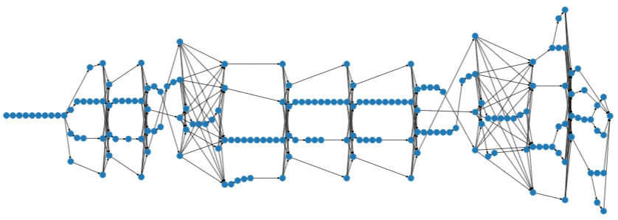

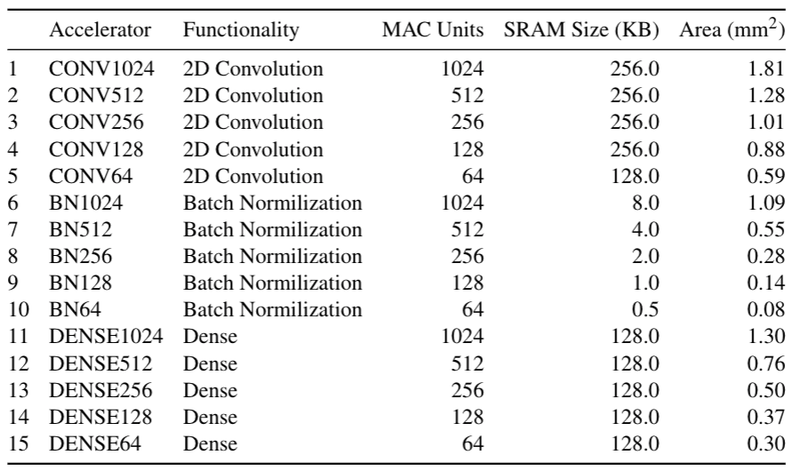
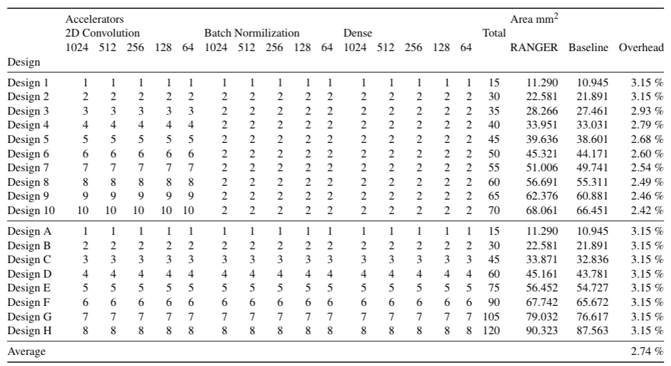
Experimental Setup
Inception-V3 DAG
Resnet, VGG
MobileNet, UNet
Inception-v3
IRIS-NN Task Graph + Host Code Generator (Python)
RISC-V
Build
Run on
RANGER Platform
(GEM5 Simulator)
Accelerators: Convolution (CONV), Batch Normalization (BN), Dense
List of kernel accelerators and their area estimations in a TSMC 16nm technology
Various heterogeneous designs, the number of kernel accelerators, and
the estimated area. Design A and B are the aliases of Design 1 and 2, respectively.

Slide 9
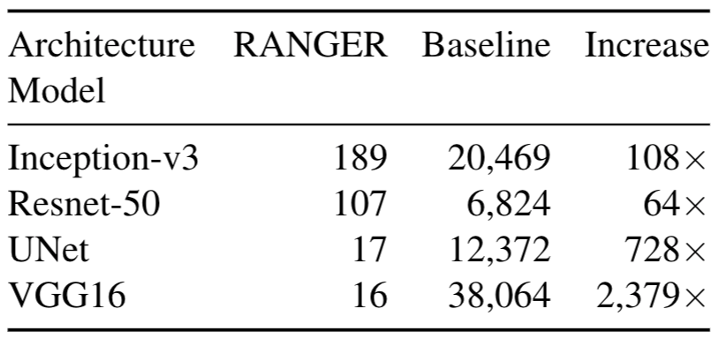
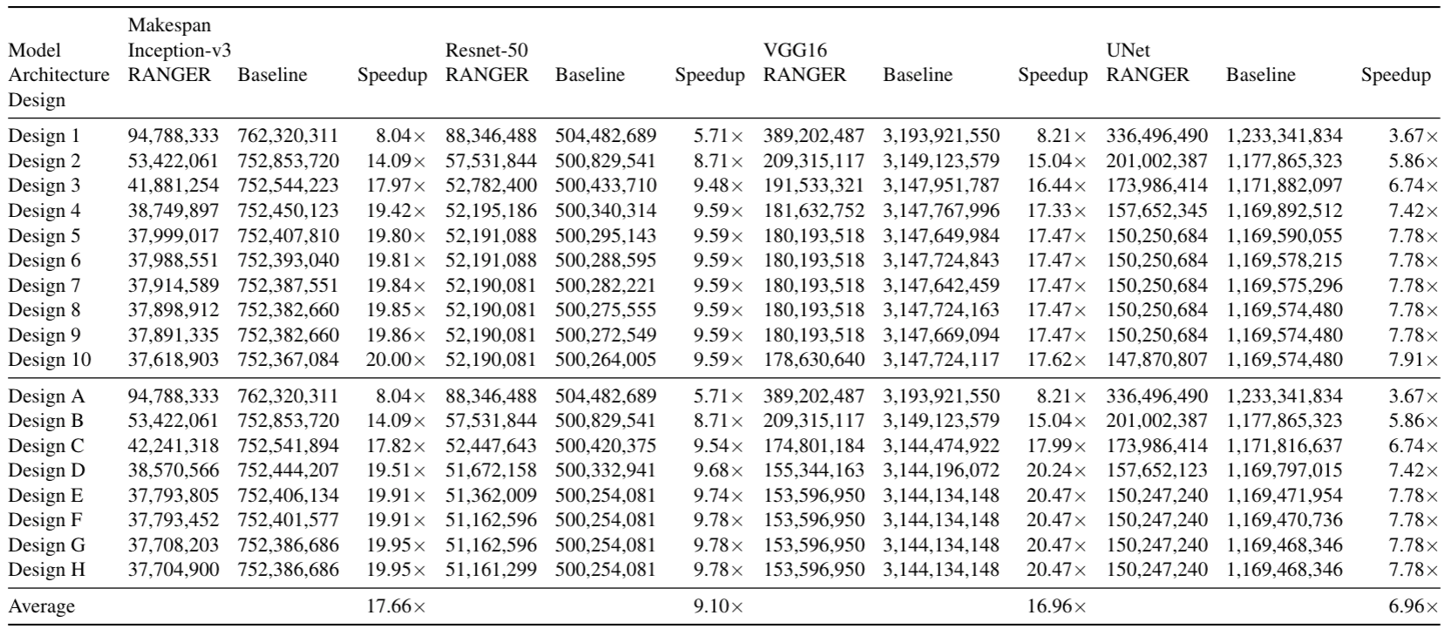
Experimental Evaluation: Makespan
Baseline: Vanilla architecture with flattened stream tasks for centralized scheduler
Comparison of makespans for various RANGER and baseline designs. On average, RANGER achieves a 12.7×speedup

Slide 10
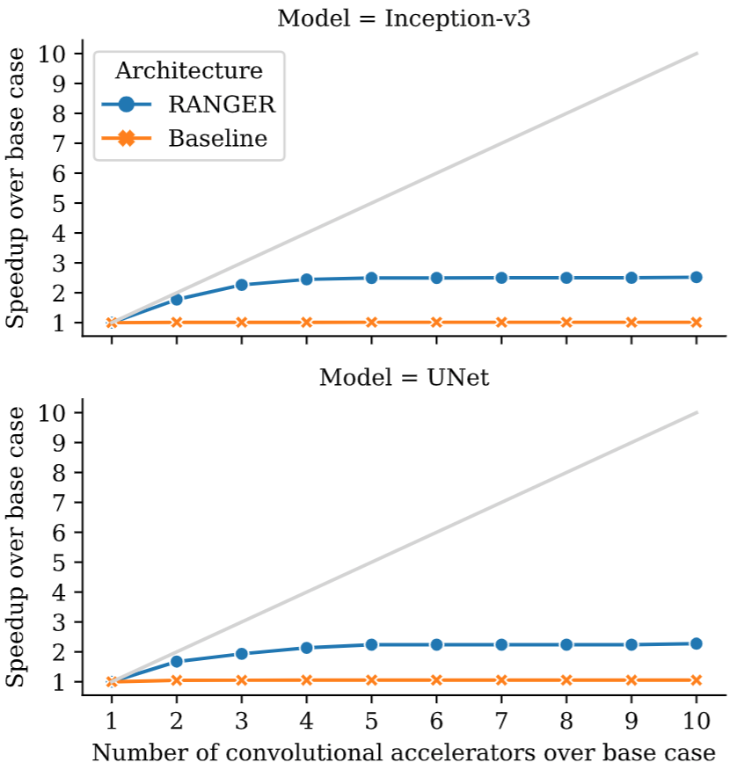
RANGER Speedup (Fixed 10 parallel instances of each application)
Inception-V3 DAG
10 instances
Measured speedup of RANGER by running 10 parallel instances of each application with respect to Designs 1–10, which contain an increasing number of kernel accelerators. The speedup plateaus at Design 3 due to an insufficient number of tasks for the available kernel accelerators

Slide 11
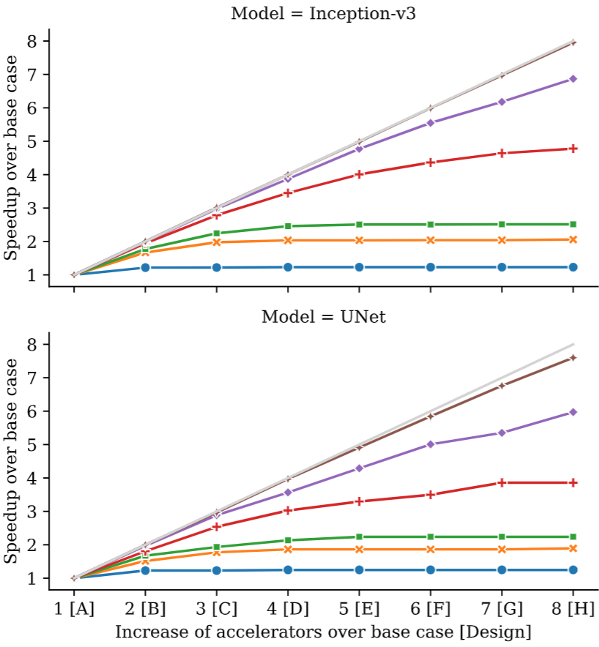
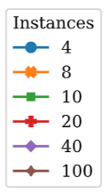
RANGER Speedup (Increasing number of application instances)
4 to 100 instances
Measured speedup of RANGER by running an increasing number of instances of the same application on Designs A–H.
RANGER demonstrates excellent scalability with 100 instances of application running in parallel

Slide 12
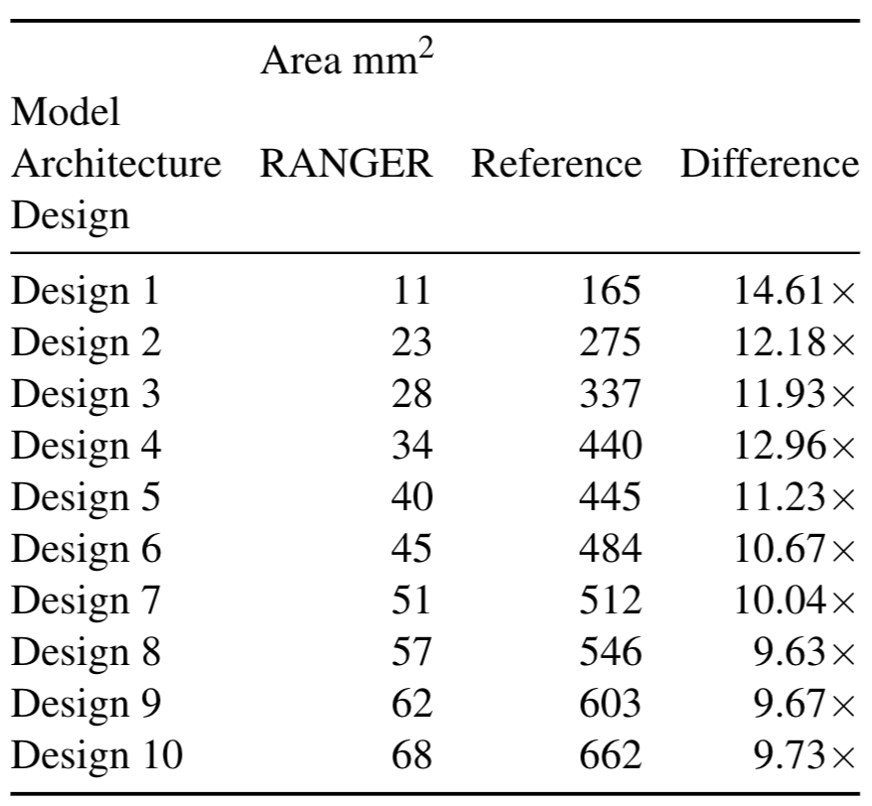
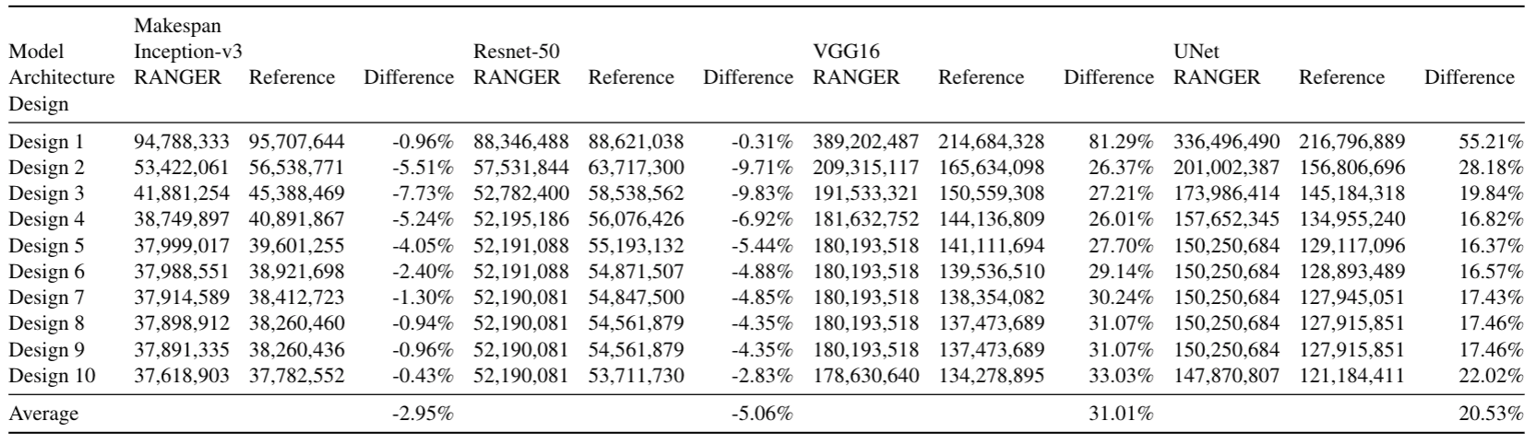
Area and Makespan Compared to Reference
Reference: (Hypothetical) Identical number of Accelerators as its RANGER counterpart, but has huge scratchpad memory
Has large scratchpad to hold complete task I/O
Requires no local task scheduler
Comparison of makespans for RANGER and reference. On average, RANGER shows only 10.88% of penalty,
which is the measurement of performance overhead of the local ASCS.

Slide 13
RANGER Summary
Presents RANGER framework (Extremely heterogenous computing)
An architecture design for hierarchical task scheduling
Hierarchical Task Scheduling
Requires coarse grained task dependency specification
Fine grain accelerator specific scheduling at lower level
RANGER uses customized RISC-V cores
Achieves 12.7x performance gain in terms of makespan
Area Overhead: +2.7% in a 16nm technology
Future work:
Experiment different scheduling policies with HUNTER and DAGGER
Hardware task scheduler

Slide 14
Adrestea: An efficient FPGA design environment for scientific machine learning

Slide 15
Why Adrestea and What is it?
FPGA Programming Challenges
Writing interface program to communicate with FPGA kernels
Writing kernels along with other heterogenous compute units
Design space exploration
Adrestea: An efficient FPGA design environment for scientific machine learning applications to run at the edge
Simplified call to FPGA kernel; Extended IRIS Runtime Framework (https://iris-programming.com)
Enables to write kernel targeting other compute units as well with run-time selection
An intelligent design space exploration environment for FPGAs
Proof of concept:
Application: Random forest classifier ; FPGA: Xilinx Alveo U250
SC 2022 Demo: https://ornl.sharepoint.com/:v:/s/CSMDSTAFF-ACSR-APG/EYN-bqYLgB5Msg_pd0oZJnUBbBTp-bkE4ba_K1CflpeGrA?e=jahFX0

Slide 16
Automated Adrastea Development Environment
1) Build Hardware Designs
Automated Builds
GitLab-CI
Slurm
Runtime
Results
Vitis Build Server
Hardware
Optimization
Loop
Bitfiles
2) Run Hardware Designs
Automated Runs
Heterogeneous Hardware Accelerators
GitLab-CI
Slurm
FPGA
Vitis Run Server
GPU
Note: Servers are VMs with the Vitis toolchain installed and hardware added
with PCIe Passthrough.
This enables:
Easy configuration of development environment.
Easy migration of VMs to new hosts for additional resources.

Slide 17
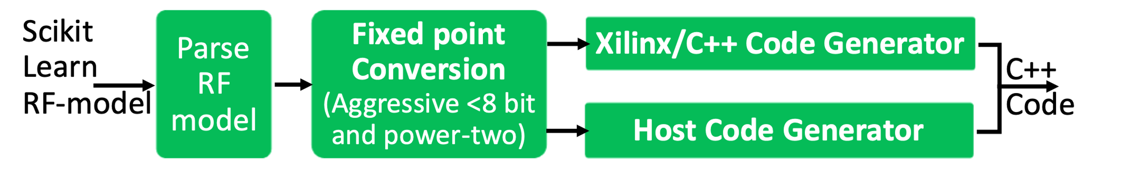
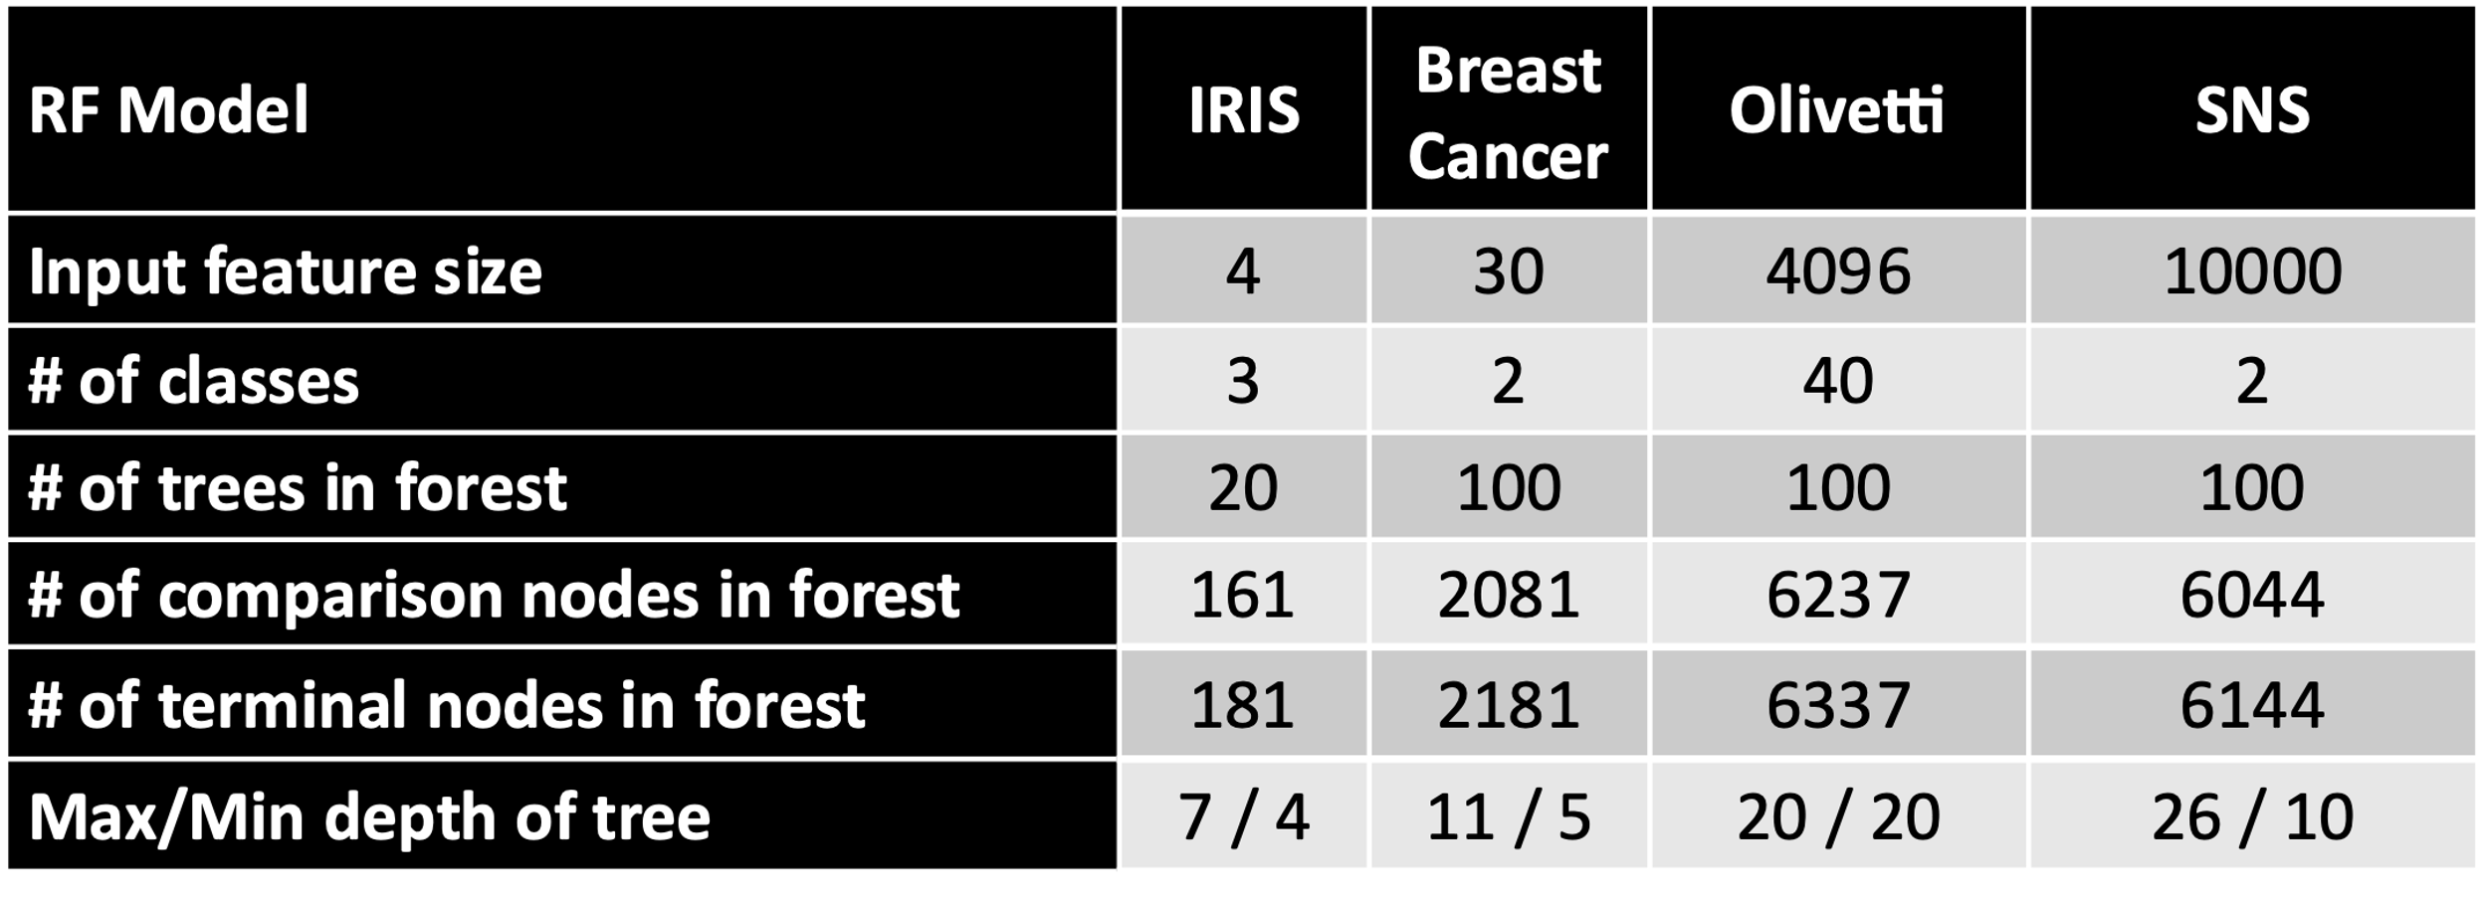
Application: Random Forest (RF) Classifier With IRIS
Random Forest Xilinx Generator Script
RF Models
Decision Tree Classification
f1 < 0.4
f3 < 0.1
1
1
f2 < 0.2
f3 < 0.1
f1 < 0.5
f2 < 0.5
2
3
2
3
f5 < 0.1
f4 < 12.5
f4 < 10.0
f5 < 0.5
4
5
4
5
a
b
Tree-1 Class
Tree-N Class
Voting (Histogram)
Majority Voting (Class with maximum votes)
XilinxCL Kernel

Slide 18
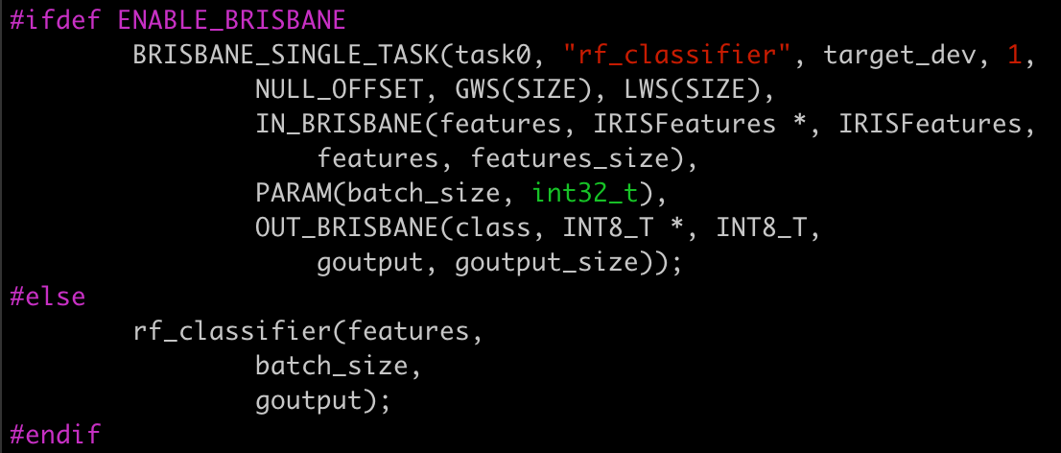
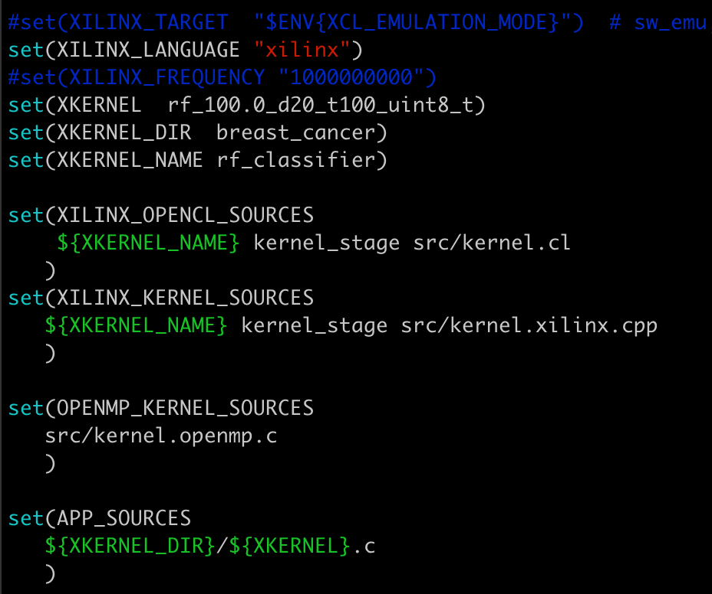
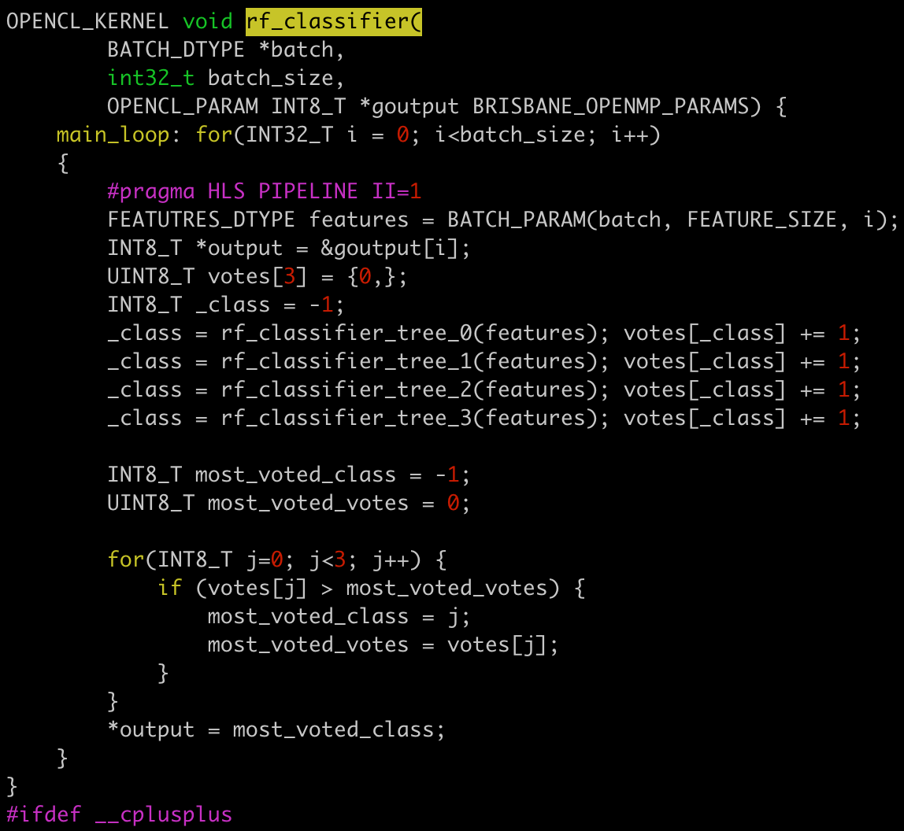
Application build with IRIS
CMakeLists.txt
FPGA (OpenCL/XilinxCL),
CPU, GPU task specification
Host Code
CPU call
kernel.cl
Kernel.xilinx.cpp
kernel.cpu.cpp
Build Commands
$ export XCL_EMULATION_MODE=sw_emu
$ cmake –DUSE_XILINX=ON ../
$ make –j install
$ cd install
$ ./irf 3 # RUN on FPGA

Slide 19
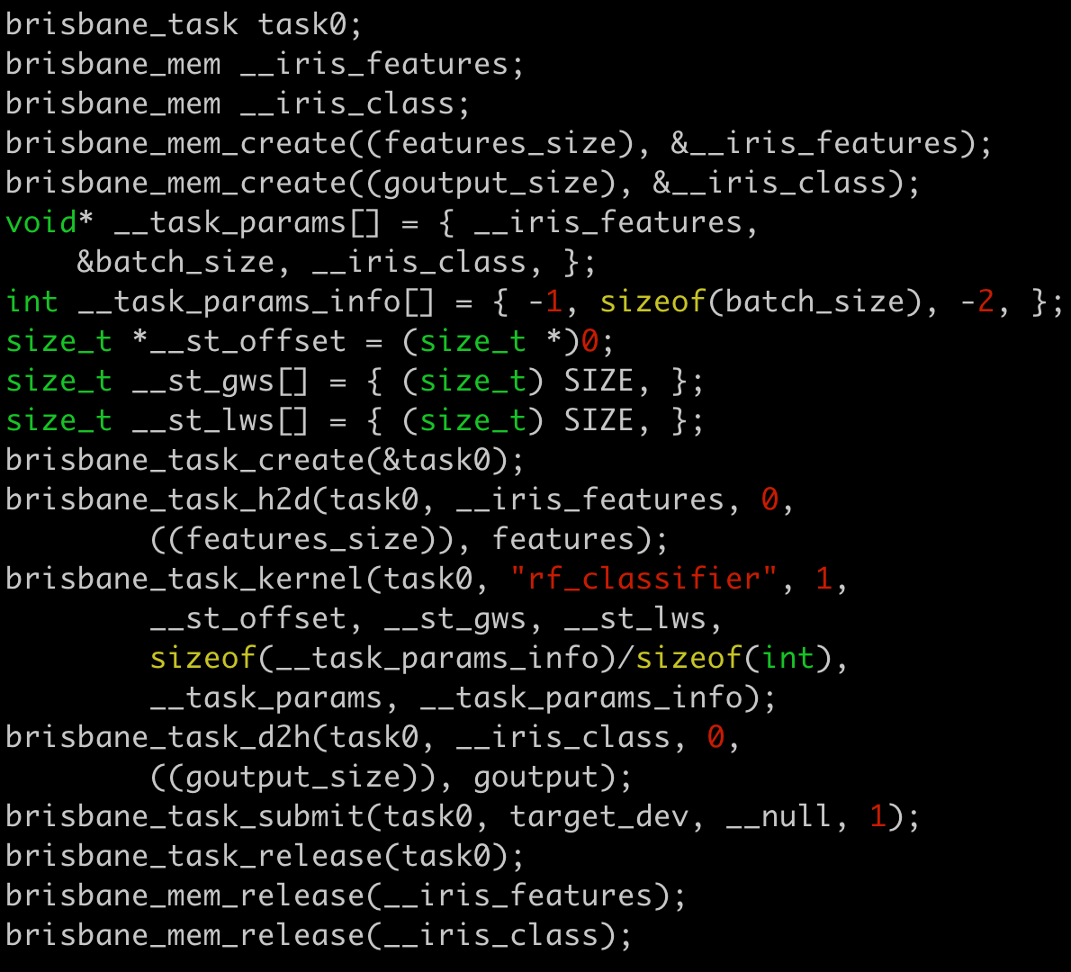
BRISBANE Macros and Interface Code Generation
IRIS Task Calls Extractor And
Kernel Interface Generator (Python)
Interface code for OpenMP/Hexagon kernels:
brisbane_rf_classifier_setarg
brisbane_rf_classifier_setmem
brisbane_setarg
brisbane_setmem
brisbane_kernel
brisbane_launch
Notes:
#IN_BRISBANE(IRIS_VARIABLE, Type, Element Type, HOST_VARIABLE, SIZE, Compute_Constraints)
#OUT_BRISBANE(IRIS_VARIABLE, Type, Element Type, HOST_VARIABLE, SIZE, Compute_Constraints)
#PARAM(VARIABLE_NAME, Type, Compute_Constraints)

Slide 20
RF Xilinx Generator Knobs and Optimizations
Algorithmic Knobs
Fixed point knobs
Data type (8-bit, 16-bit, 32-bit)
Bitwise optimizations
Data layout optimizations
Features pruning
Voting arithmetic fusion
Static single assignment of Voting
Early prediction with confidence
Configurable number of M-AXI interfaces and bitwidth
Streaming tasks
Build knobs
Clock Frequency
Compiler pragmas
#pragma HLS PIPELINE II
#pragma HLS INTERFACE axis port=classify_stream
#pragma HLS INTERFACE m_axi port=batch_g0 bundle=maxiport0 offset=slave
#pragma HLS INTERFACE ap_ctrl_none port=return
#pragma HLS DATAFLOW
#pragma HLS array_partition variable=
#pragma HLS inline
#pragma HLS unroll

Slide 21
S: Sampling (Indexes)
PV: Parameter Values
PN: Parameter Normalized Values
EO: Evaluation Output
BOE: Batch Output of Extraction (Cost metrics)
BOI: Batch Output of Inference (Cost metrics)
Automated Design Space Exploration
DEFFE: https://github.com/miniskar/deffe/tree/release.v1
[Miniskar et.al. CF2021]
validate.py
Config.json
0_single.py
0_single.py
: Stream Queue
Knobs, Costs and Explorations
: Function Call
(evaluate)
(extract)
BOE
Sampling
S
Extract Parameters
S, PV, PN
Build
S, PV, PN, EO
Run & Extract
Write
S
Extract Parameters
ML Training
S, PV, PN, BOE
S, PV, PN
ML Inference
BOI
BOI
DEFFE
Sequential and Parallel threads with Streams
Sampling techniques: Random, DOEPY sampling techniques: Fractional factorial, Plackett Burman, Sukharev Grid, Box-Wilson, Latin hyper cube (LHC), Space filling LHC, Random K-mean cluster, Maximin, Halton, Uniform random matrix, DEFFE-Smart, DEFFE-One-dimension (Onedim)
ML: Keras/PyTorch-DNN, Random Forest, SVM
Evaluate: Multi-Thread, Slurm
Knobs
Bitwise
Optimizations
1: Yes
2: No
# M-axis
1: 1
2: 2
3: 4
2
3
1
2
1
1
Base
3
2
1
5
4
2
3
Fixed Point
Threshold
1: 100%
2: 90%
3: 80%
4: 70%
Frequency
1:50MHz
2: 100MHz
3: 200MHz
4: 300MHz
5: 500MHz
4
Onedim

Slide 22

Single Run Script
Single.py
Analyze.ipynb
DEFFE
Input
Build
Run and
Extract
Output
Test Dataset
Generator
Automated
FPGA Build
Automated Run and Collect Cost Metrics
Cost Metrics
RF Model
Design Space Parameters
HLS Design
FPGA Design

Slide 23
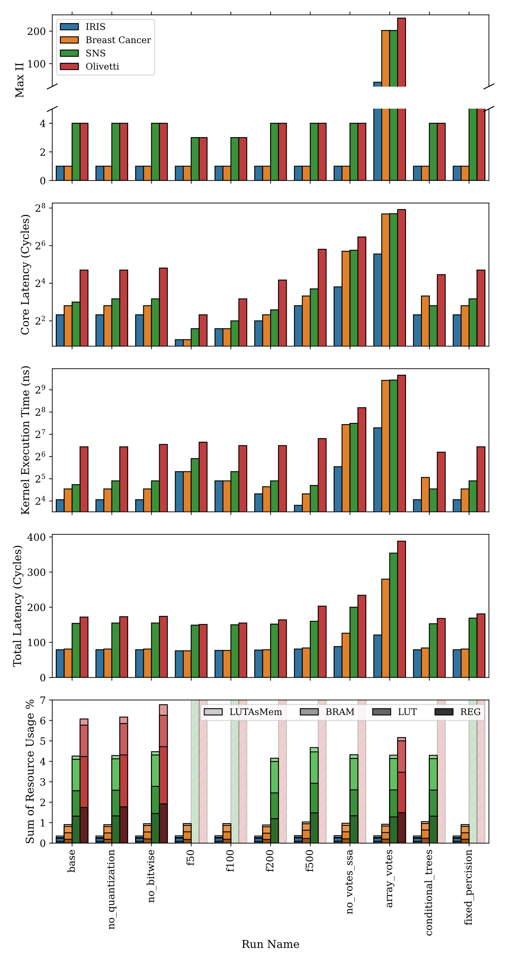





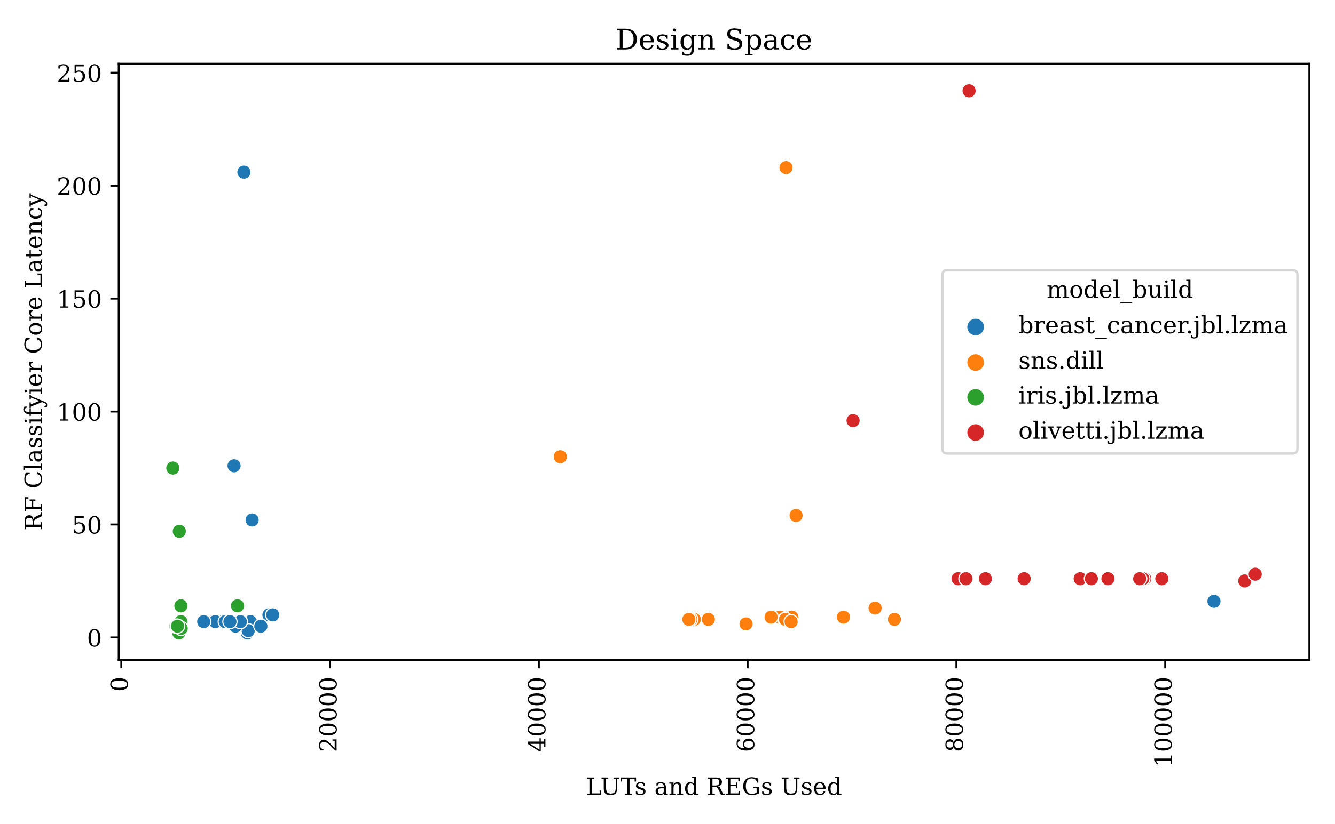
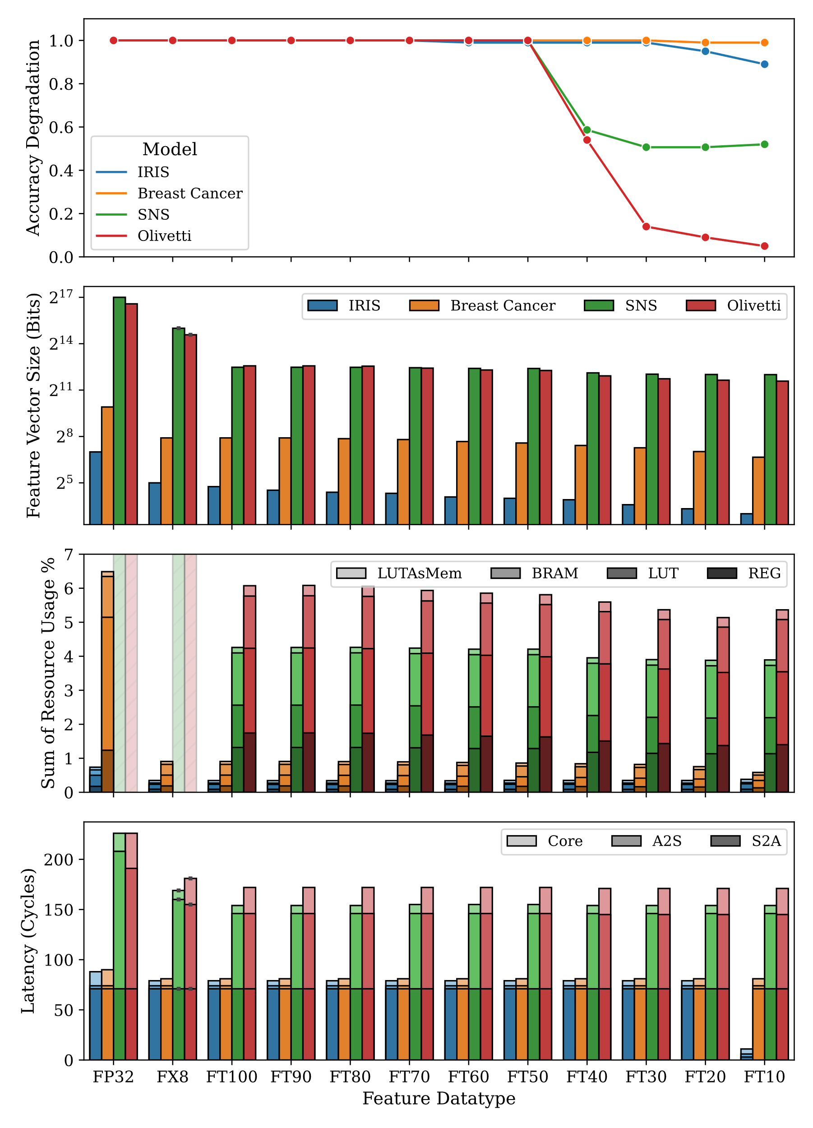
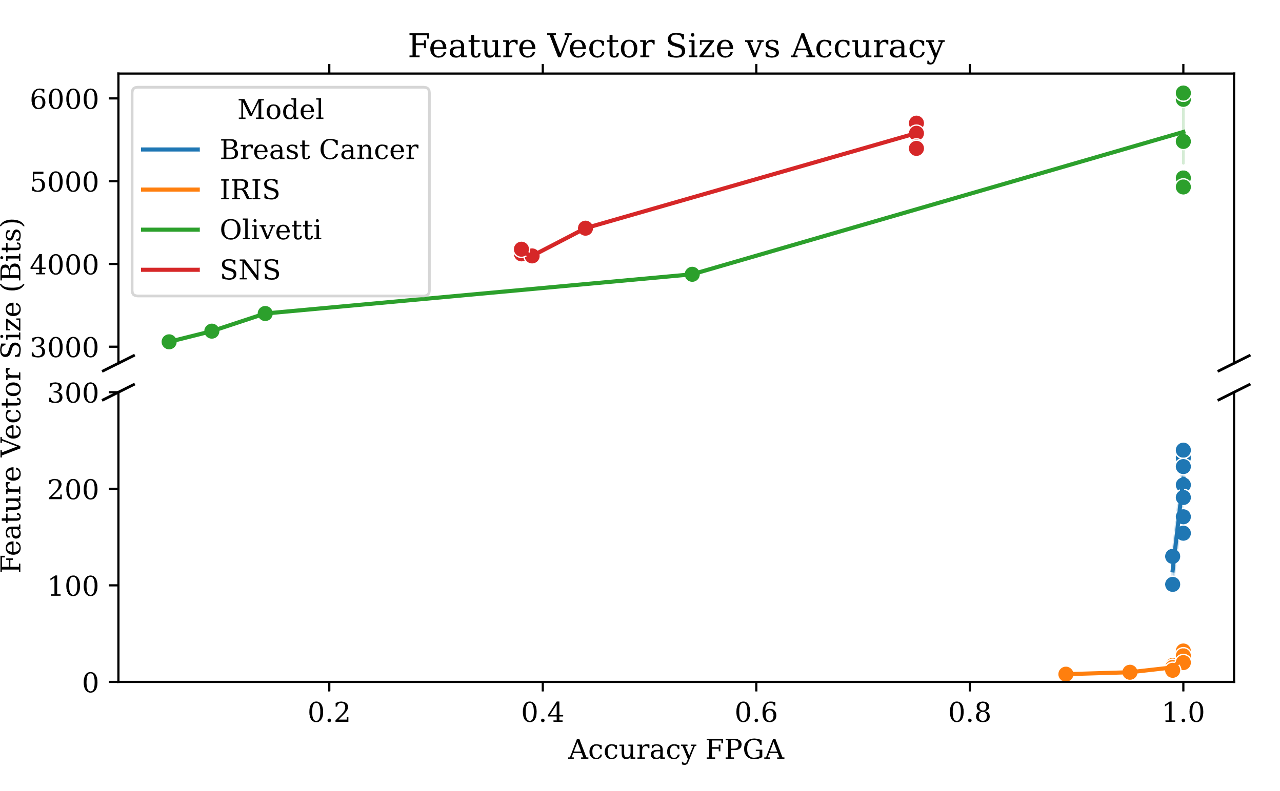


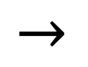
Analyze Jupyter Notebook
$$→$$
$$+$$
$$+$$
Cost Metrics

Slide 24
Thank you

Slide 25
Resnet, VGG
MobileNet
Inception-v3
IRIS-NN Task Graph + Host Code Generator (Python)
RISC-V
Build
Run on
RANGER Platform
(GEM5 Simulator)

